Slide 1
Android: SQLite
Lab 06
2017-2018

Slide 2
Agenda
Movies Example Cont’.
Update
Delete
Activity Lifecycle
Employee’s Example

Slide 3
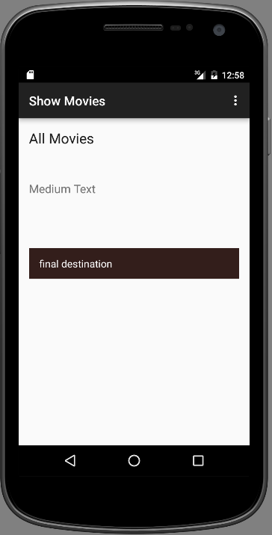
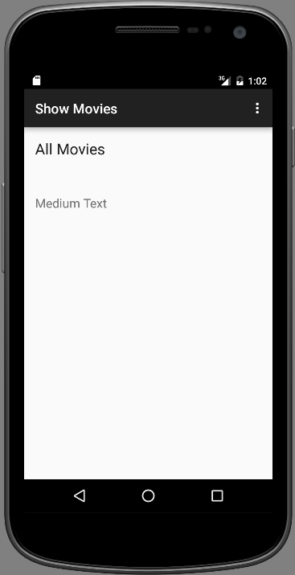
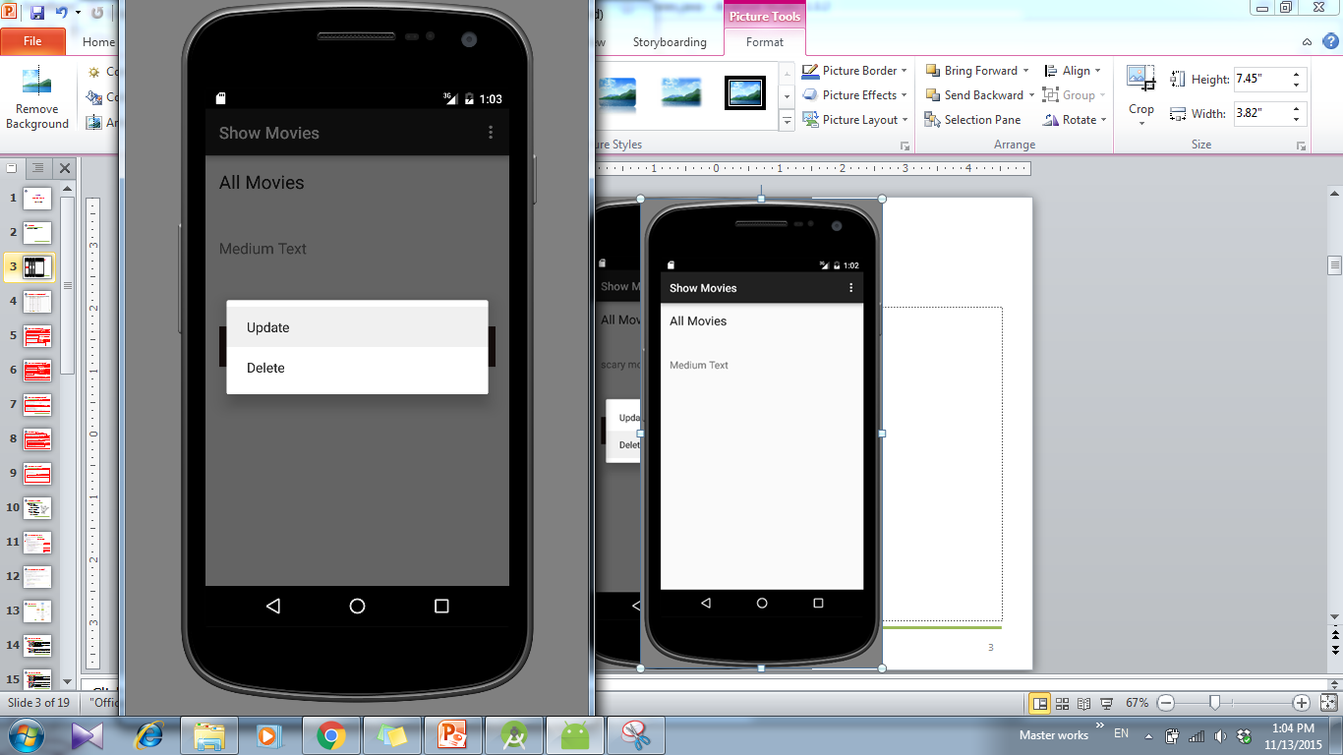
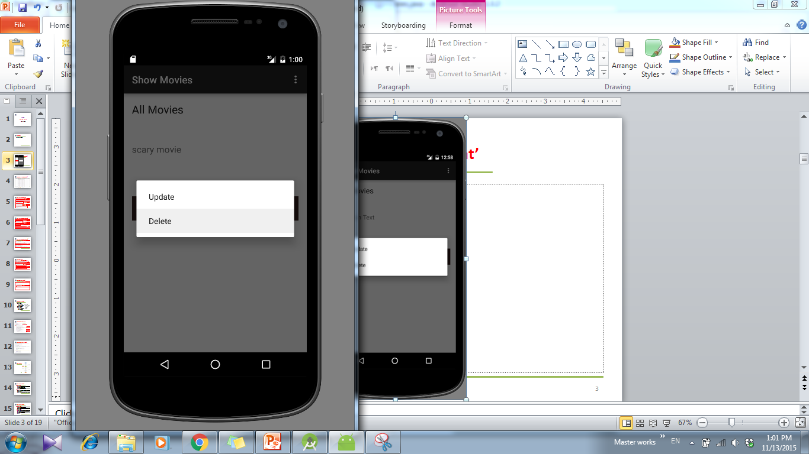
Show Movies Activity

Slide 4
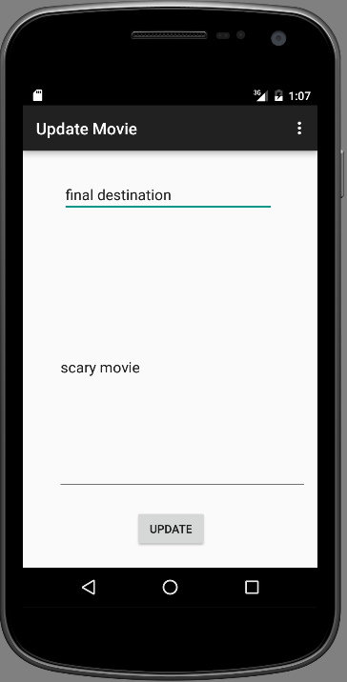
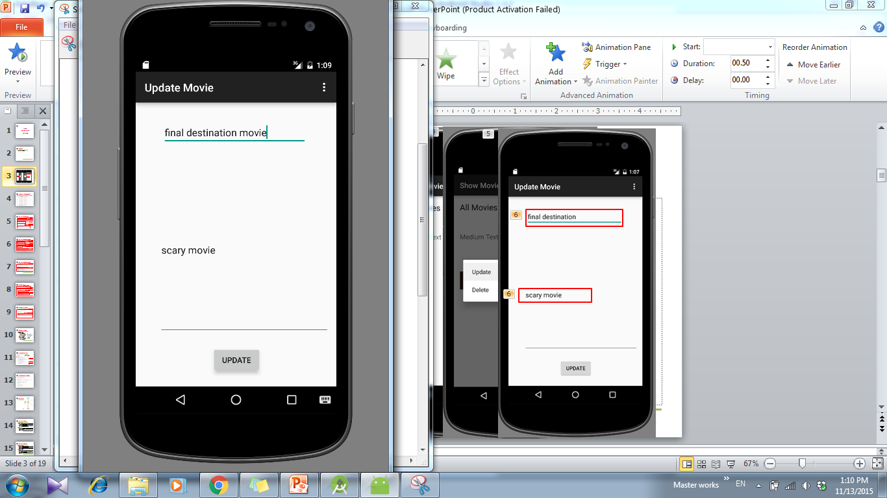
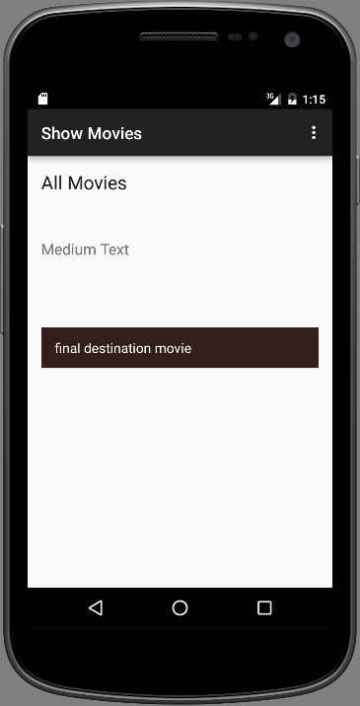
Update movie Activity

Slide 5
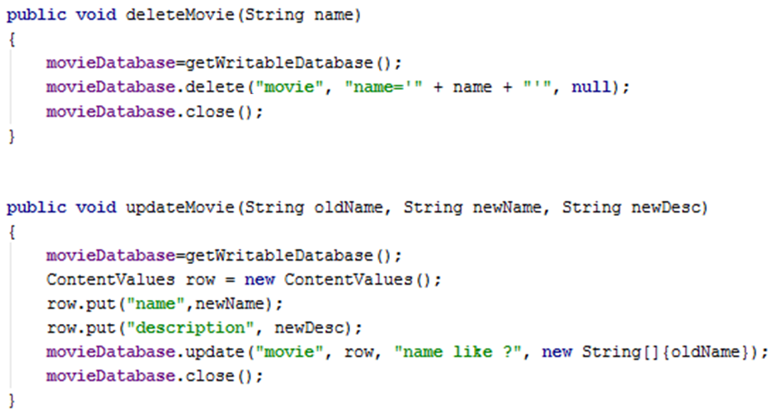
DatabaseHelper Class Cont’
Notes:
OR String upd="Update movie set name=?, description=? where name like ?";
movieDatabase.execSQL(upd, new String[]{newName, newDesc, oldName});

Slide 6
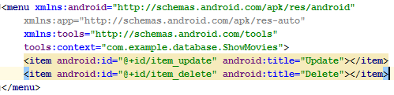
ShowMovies Context menu items

Slide 7
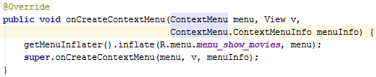
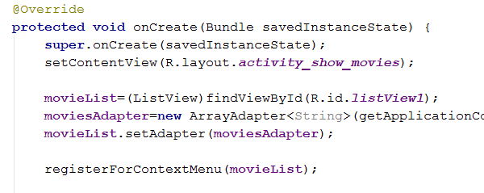
ShowMovies Activity Cont’

Slide 8
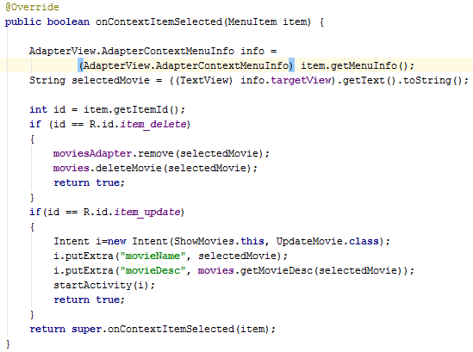
ShowMovies Activity Cont’
Get information about the view in the listView which create the context menu
Delete the item from the list and the database
Send extra data with the intent to the called activity

Slide 9
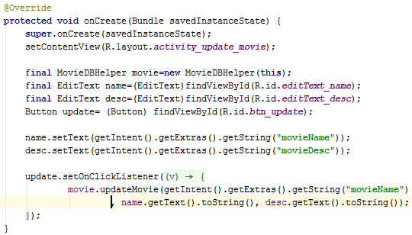
UpdateMovie Activity
Get extra data from Intent

Slide 10
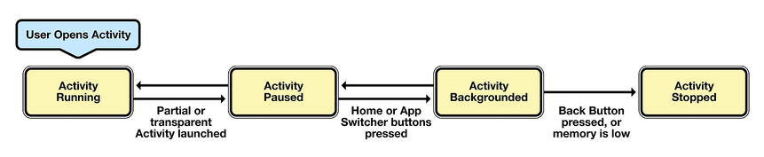
Activity Status
Notes:
http://www.codelearn.org/android-tutorial/android-activity
https://developer.xamarin.com/guides/android/application_fundamentals/activity_lifecycle/

Slide 11
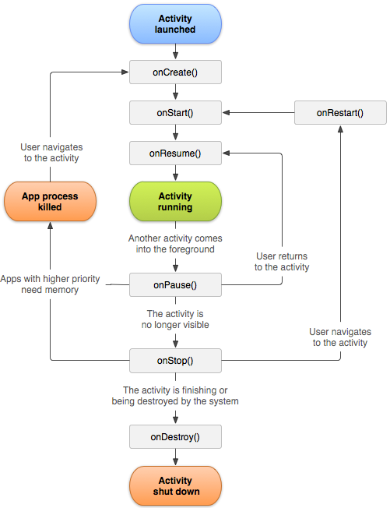
Activity Lifecycle
The activity lifecycle is implemented as a collection of methods the OS calls throughout the lifecycle of an activity.
These methods allow developers to implement the functionality that is necessary to satisfy the state and resource management requirements of their applications.

Slide 12
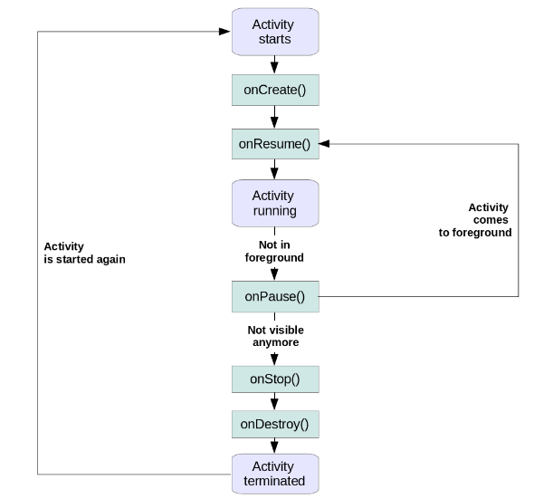

Slide 13
Activity Lifecycle
OnCreate:
Is called when your Activity is getting created for the first time. Take the example of screen rotation, during which your Activity gets killed and OnCreate is called again.
It is getting passed a variable of class Bundle. Bundle is typically used to store the state of your Activity.
OnStart:
It is called just before the Activity becomes visible to the user.
You can use onStart to reset Activity data, reinitialize variables etc.
Notes:
OnCreate: Take the example of screen rotation, during which your Activity gets killed and OnCreate is called again. You can determine if the Activity was already there using Bundle so that you do not have to create the Activity again.
Why is this necessary, imagine you have a form and user has already filled some of the fields. Suddenly the user rotates his screen. Using Bundle, Android retains the values of these fields and re-populates the data after rotation automatically. The value of Bundle will always be null when Activity is getting created for the first time.

Slide 14
Activity Lifecycle
OnResume:
onResume gets called when your Activity comes into the foreground, and it becomes visible to the user.
onResume is a good place to refresh your UI with any new changes which might have occurred during the period in which the Activity was not visible.
onPause:
onPause is called when another android activity comes on top of your Activity.
It is always guaranteed that whenever your Activity is becoming invisible or partially invisible
Notes:
Onpause:But once onPause is called, Android reserves the right to kill your Activity at any point. Hence you should not be relying on receiving any further events.
In OnPause, we either release the resources, or save the application data

Slide 15
Activity Lifecycle
OnStop:
onStop is called when your Activity is no longer visible to the user, it is similar to onPause but here you will not see your android activity entirely.
OnRestart:
It is similar to onCreate, but onRestart gets called only after onStop.
OnDestroy:
This is the method which will be called when your Activity is getting killed. This is the final call the Activity will receive in its Lifecycle.
When the user press back button on any Activity the foreground activity gets destroyed and control will return to the previous Activity.
Notes:
OnStop():You can use this method as well to store the state of your application
So what is the difference between onPause and OnStop ? If an Activity comes into the foreground and fills the screen such that your current activity is not at all visible, your current android activity will be called with both onPause and onStop . If, however, an Activity that comes to foreground does not fill the screen and your current Activity is partially visible, your current Activity will be called with only onPause.
Typically whenever you see a dialog box which requires your attention like battery low, network connection your current android activity becomes partially visible and popup box comes on the top. This is the point where only onPause will be called.
OnRestart:A good example of this would be when the user presses the home button while on an activity in the application. When this happens OnPause and then OnStop methods are called, and the Activity is moved to the background but is not destroyed. If the user were then to restore the application by using the task manager or a similar application, Android will call the OnRestart method of the activity.
This is the method which you can use to know if your application is starting afresh or getting restarted.
onDestroy:Even though you should always use onPause and onStop to clean up resources, release connections etc; onDestory is there to let your app have the final chance to clean things up before the Activity cease to exist.

Slide 16
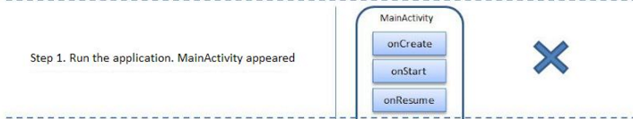
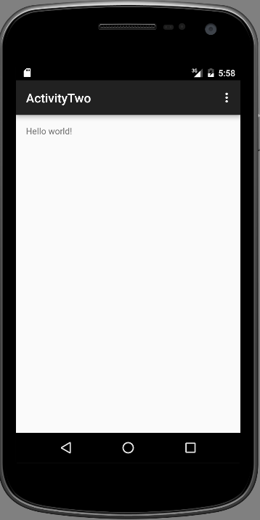
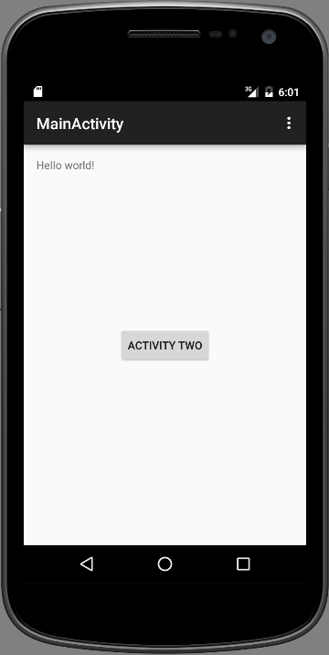
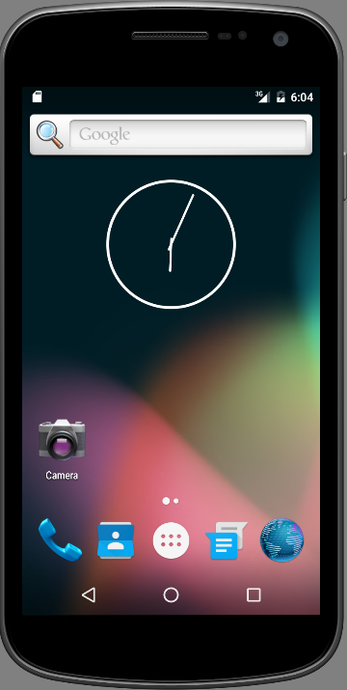
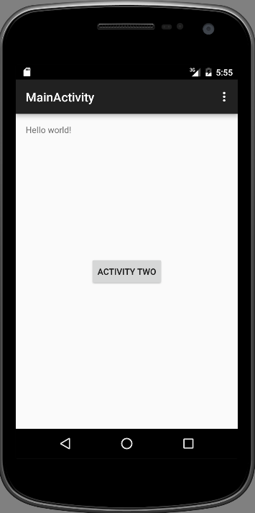
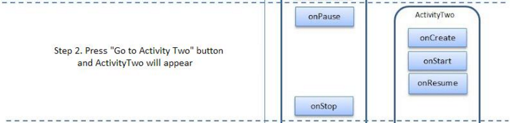
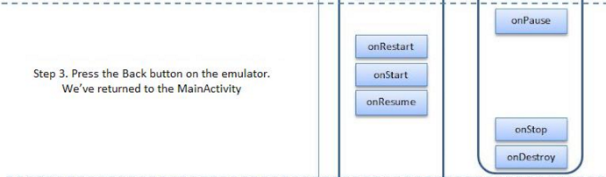
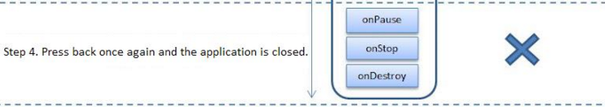
Activity Lifecycle Test

Slide 17
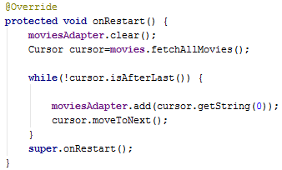
AllMoviesActivity
OnRestart method to update listview with new data from database.
Clear the adapter
Create cursor object to point to fetched movies
Get the movie name and add it to the ArrayAdapter then move to the next movie

Slide 18
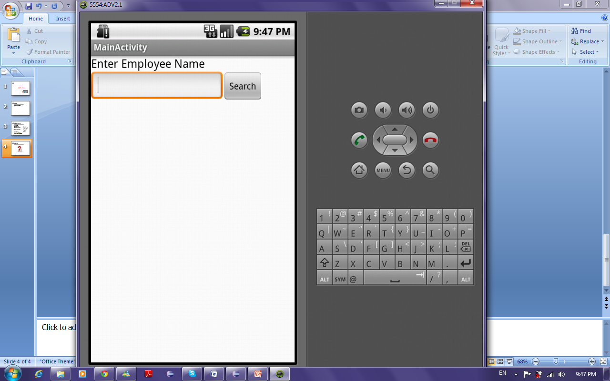
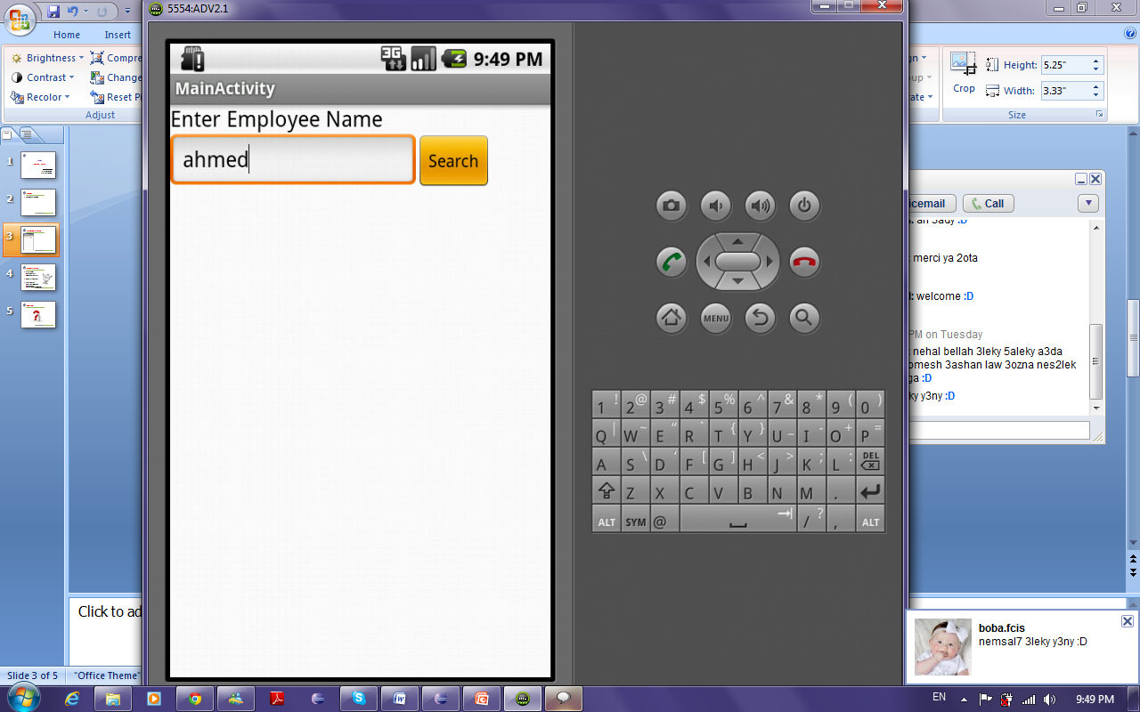
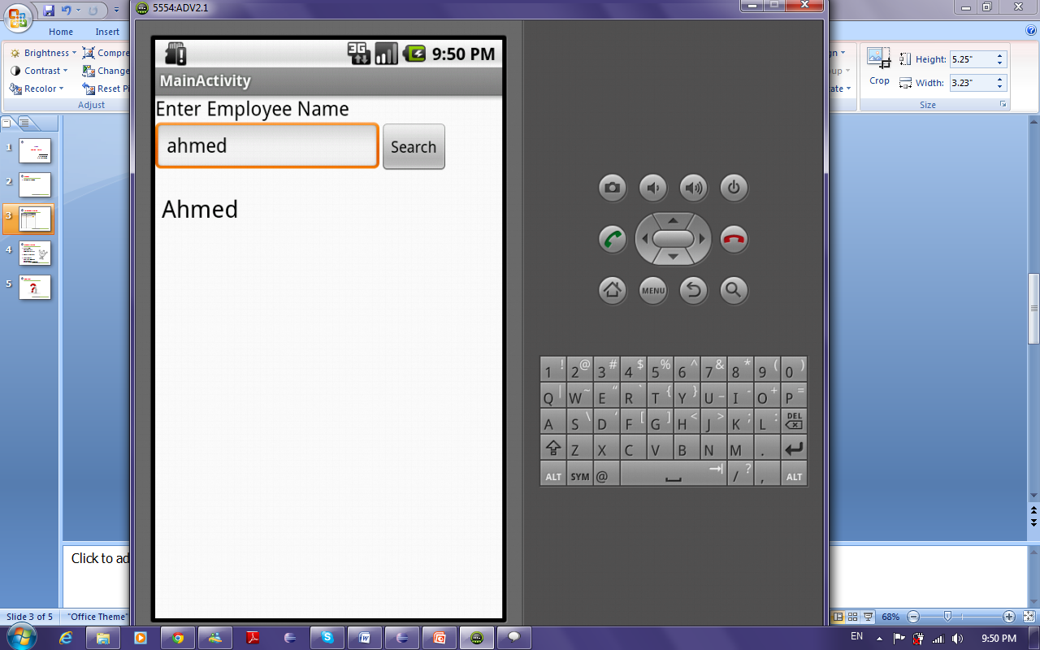
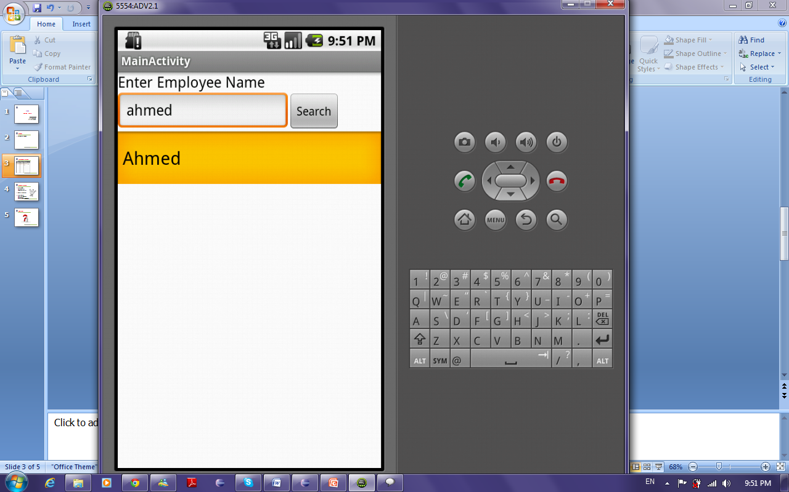
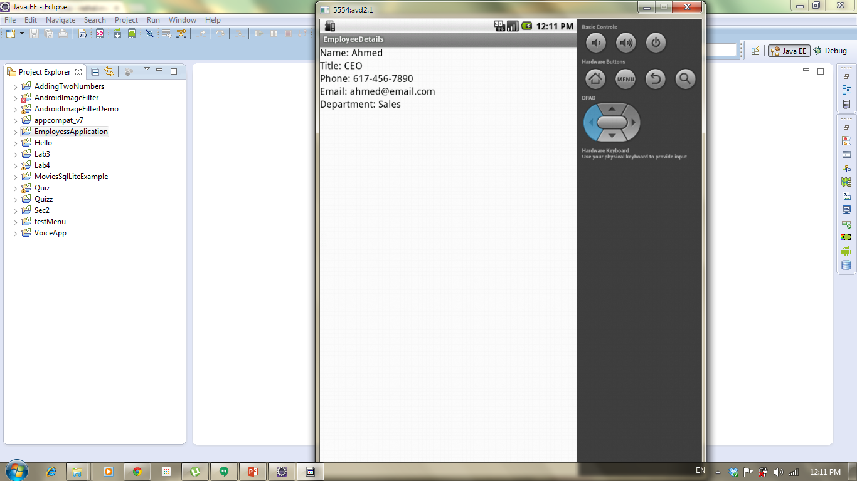
Employees Example

Slide 19
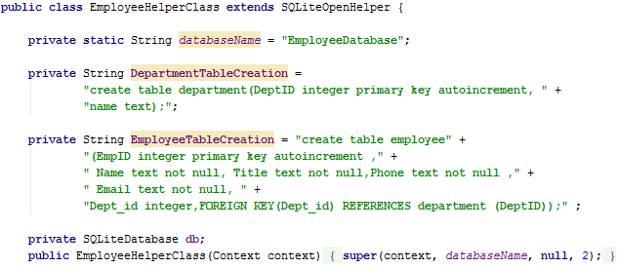
EmployeeHelperClass
Database Name variable
DepartmentTable Creation
Employee Table Creation
SQLite Database Variable
Constructor

Slide 20
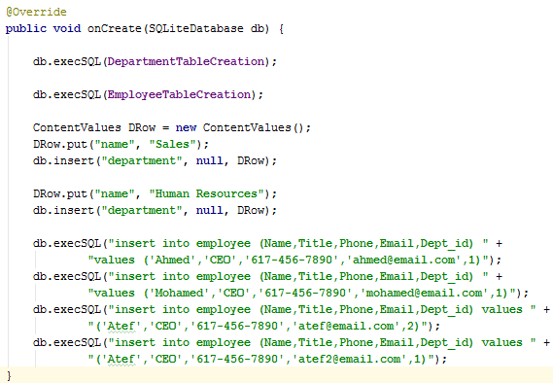
EmployeeHelperClass Cont.
Execute Department table creation statement
Execute Employee table creation statement
Insert Department data using ContentValues Class and SQLiteDatabase varaible
Insert Employee data using execSql

Slide 21
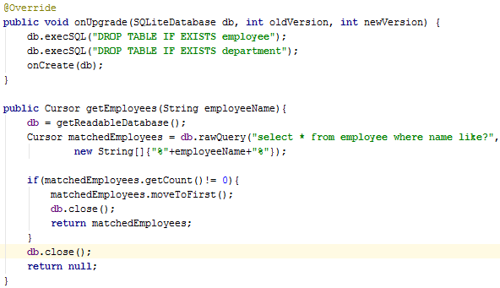
EmployeeHelperClass Cont.
Upgrade database if schema changed
Get Employess having names containing employeeName passed
Initialize SQLiteDatabase to read data
Select Query , executed into a cursor
If there are employees with passed name let cursor point to the first employee and return it

Slide 22
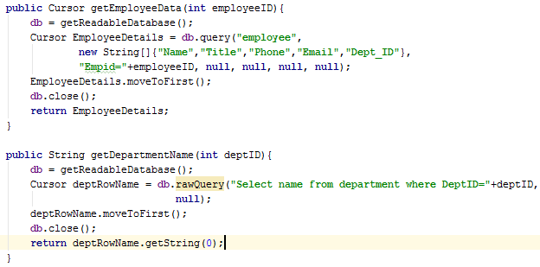
EmployeeHelperClass Cont.
Get Employee with a certain ID
Initialize SQLiteDatabase to read data
Select statement, executed into a cursor
Get Department with a certain ID
Select statement, executed into a cursor
Initialize SQLiteDatabase to read data

Slide 23
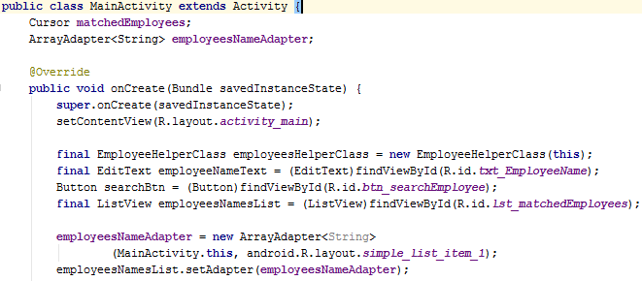
Main Activity

Slide 24
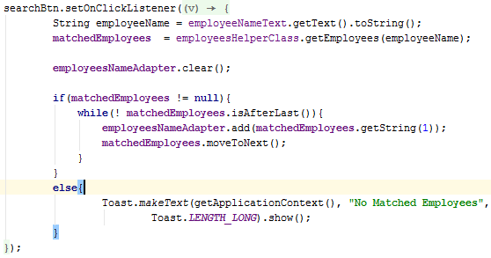
Main Activity
Set OnClickListener on search btn
Call getEmployees Method from helper object
If there are matched employees: Loop over Cursor
Else: Show user msg that no employees found
Add Employee name and move to next employee
Show message to user

Slide 25
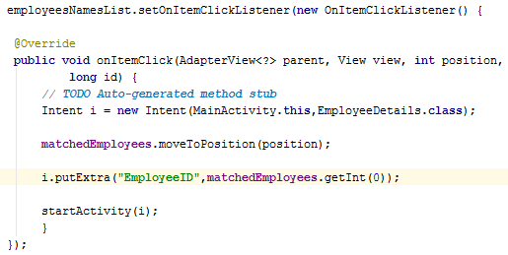
Main Activity Cont’
Set onItemClickListener on ListView
Create Intent Object
Let Cursor points to the selected Employee
Pass Employee ID through Intent
Start the other Activity

Slide 26
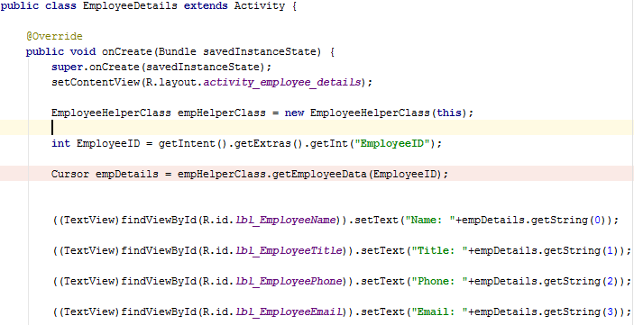
EmployeesDetails Activity
Create Object From Helper Class
Get Employee ID passed with intent
Call getEmployeeData Method
Set TextViews With selected Employee Data

Slide 27
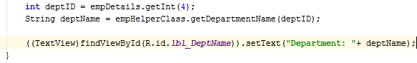
EmployeesDetails Activity Cont’

